Slide 1
Git – Working With Others
AI2C Tech Intro

Slide 2
Review…

Slide 3
Objectives
Push changes to a remote repository from a local repository
Pull changes from the remote repository to the local repository
Discuss origins, forks, and upstreams

Slide 4
Remotes and Origins
Cloning – automatically sets up an “origin” remote url tracking that repository
Fetch, pull, push all work on that “origin” repository
Can specify an alternate name or repository
git remote -v
git remote show origin
Why might I ever use multiple remotes?
Notes:
git remote --add --push {url1}
git remote --add --push {url2}

Slide 5
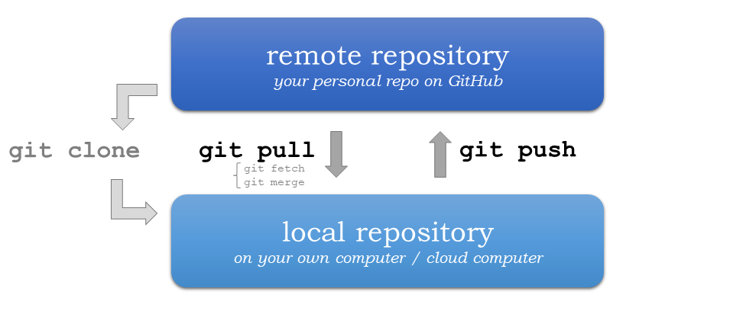
Pushing and Pulling

Slide 6
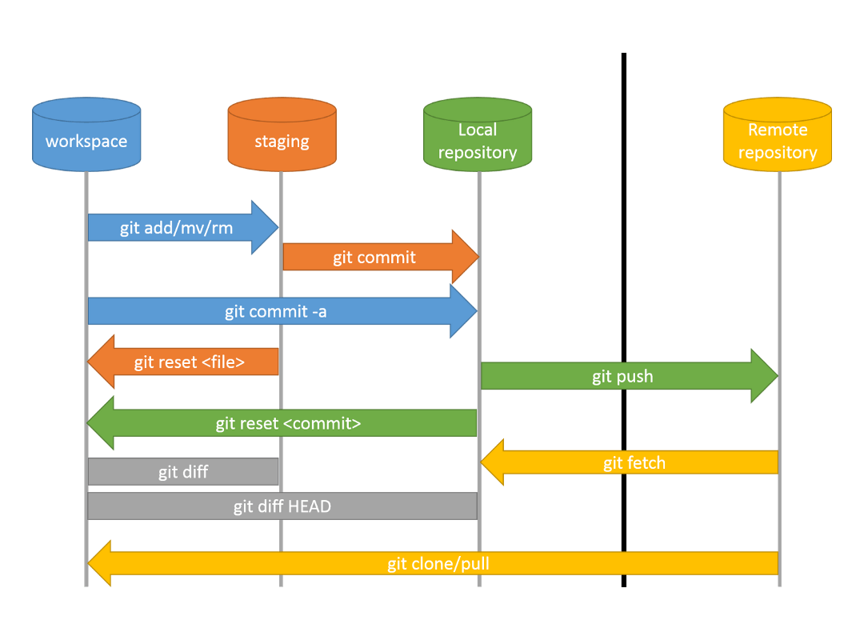
Git Pull

Slide 7
Forking and Upstreams
Read this link to the “Prerequisites” section: https://docs.github.com/en/pull-requests/collaborating-with-pull-requests/working-with-forks/fork-a-repo
What is a fork? What uses does it have?

Slide 8
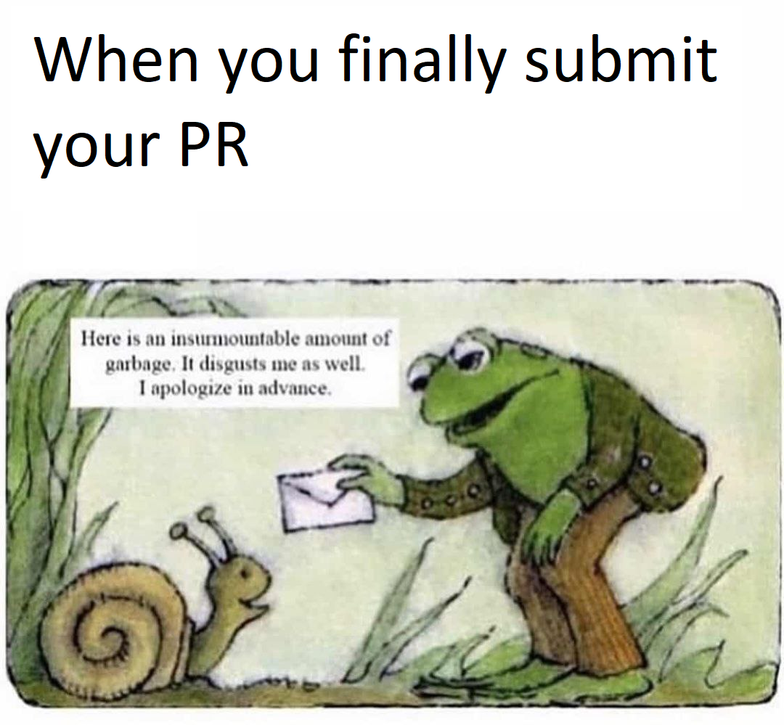
Pull Requests
Should really be named a “merge” request.
“Would you please merge my changes into your repository?”
If forked, the original developers need to pull from your repository to do the merge

Slide 9
Hands-On #1
Inspect git remotes
Push/pull from a remote repository
Fork a remote repository and issue a pull request

